Slide 1


Employee Attrition Prediction
Vinay Nagaraj
DSC680, Summer 2021
Bellevue University, NE

Slide 2
Problem Statement
Attrition can make a big dent in your organization’s bottom line as well as its culture. For an organization to perform successfully, it is important that the employer and the employee have a good relationship and understanding.
When an employee decides to quit, there will be a lot of challenges for the employer. It will impact their productivity, revenue, experience and also time invested in training the employee.
This project intends to identify the factors that lead to employee attrition and build a classifier model that would help an organization in predicting the employees that can leave the organization.

Slide 3
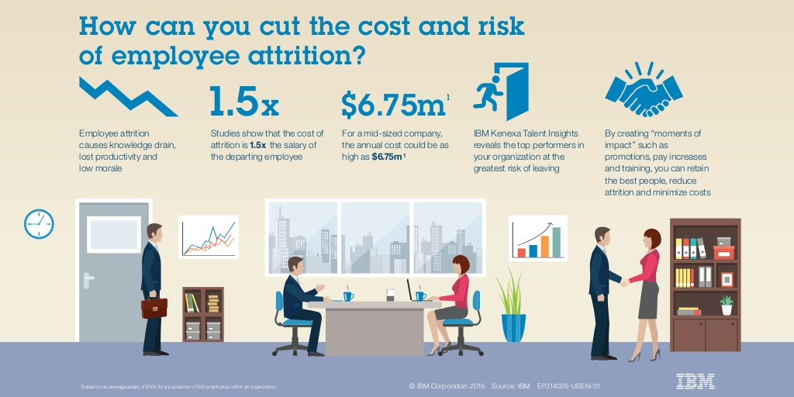
Employee Attrition Cost Statistics
According to the U.S. Bureau of Statistics, the average turnover rate in the U.S. is about 12% to 15% annually.
The Society for Human Resource Management (SHRM) reported that on average it costs a company 6 to 9 months of an employee's salary to replace him or her.

Slide 4
Process Overview
Preliminary analysis on data
Data preparation and cleaning for any missing values.
Perform Exploratory Data Analysis
Train and test models
Model evaluation and tuning

Slide 5
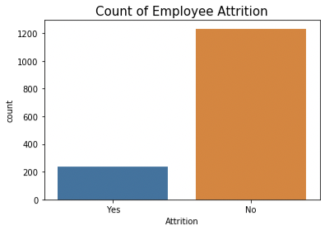
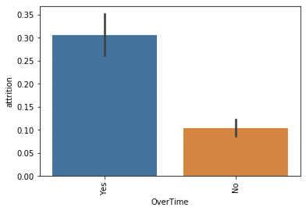
Dataset Overview
The dataset used is a fictional data set created by IBM data scientists and available on Kaggle.
Out of 1,470 records, 237 are data related to Employees who left.
Working ‘OverTime’ is a majorly contributing factor to Employee Attrition.

Slide 6
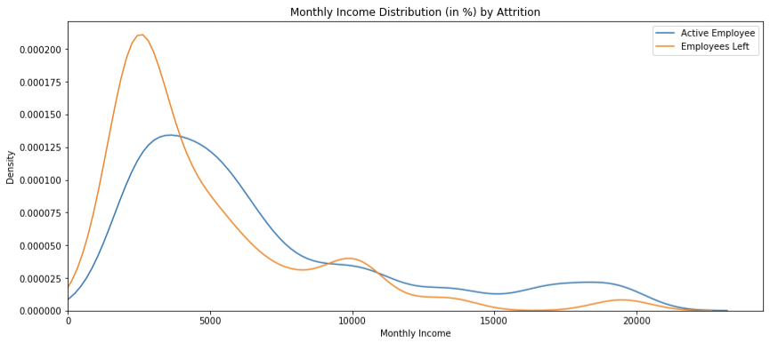
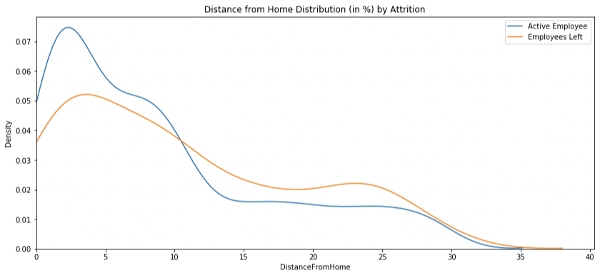
Dataset Overview
Employees who are traveling for more than 10 miles to work daily are more likely to leave.
Employees with monthly income of less than 5,000 are more likely to leave.
Job Satisfaction is also very important for employees to stay in the same company.

Slide 7
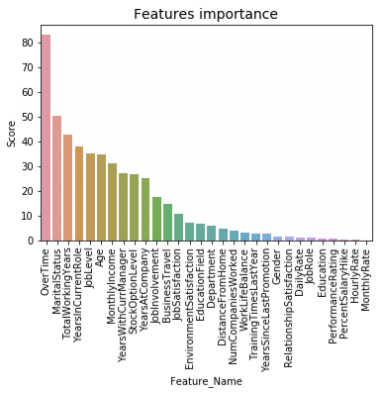
Feature Importance
Target variable – “Attrition” which determines if the Employee has left the company or not.
SelectKBest technique used to identify most relevant features.
‘OverTime’ plays a vital role in Attrition.

Slide 8
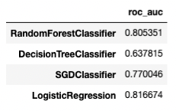
Classification Models
Aggregate measure of performance across the 4 classification models is shown here.
We choose to use RandomForest and Logistic Regression model due to their accuracy scores.

Slide 9
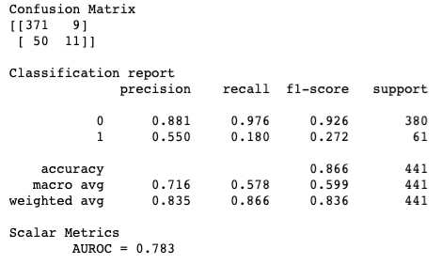
Random Forest Model
Random Forest Model provides us a high true prediction values for our dataset.
78.3% of the time, our model will correctly predict if the employee will be leaving the company or not.

Slide 10
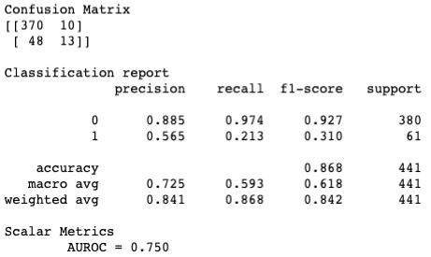
Logistic Regression Model
This model has an AUROC of 0.75 which means that the model has very good discriminatory ability.
75% of the time, our model will correctly predict if the employee will be leaving the company or not.

Slide 11
Conclusion
As proven by Graph Analysis and SelectKBest, ‘OverTime’ plays a major factor in employee attrition.
Random forest model has fewer false positives than logistic regression making it a better model.
Best suited classification model for our dataset would be Random forest model.
Ingesting more data to our machine learning model will help us get better results from what we have achieved here in our research.

Slide 12
References
Pavansubhash. (2017, March 31). IBM HR Analytics Employee Attrition & Performance. Kaggle. https://www.kaggle.com/pavansubhasht/ibm-hr-analytics-attrition-dataset
Zojceska, A. (2020, April 3). HR Metrics: How and Why to Calculate Employee Turnover Rate? Blog. https://www.talentlyft.com/en/blog/article/242/hr-metrics-how-and-why-to-calculate-employee-turnover-rate
randerson112358. (2020, March 31). Predict Employee Attrition. Medium. https://medium.com/analytics-vidhya/predict-employee-attrition-a34e2c5a972d

